Slide 1
Zero Knowledge Proofs => Zcash
CS 1501 Introduction to Blockchain

Slide 2
ROADMAP
Zero Knowledge Proofs
Brief History of Digital Privacy
Zcash => zk-SNARKs
Cool parameter generation story (about Zcash)
zk-STARKs?

Slide 3
Can we ever prove we know something without revealing the details of the secret?
YES, with Zero Knowledge proofs!
> prove to you that I know the answer to a question without revealing the answer
> In the context of blockchain, allow transactions to be verified without revealing the sender, receiver, or transaction amount

Slide 4
Zero Knowledge proofs must have:
Completeness
If the prover is telling the truth, they will eventually convince the verifier
Soundness
A prover can only convince the verifier if they are actually telling the truth
Zero-knowledgeness
Verifier doesn’t learn anything else about the prover’s information
[Goldwasser, Micali, Rackoff 1985]

Slide 5
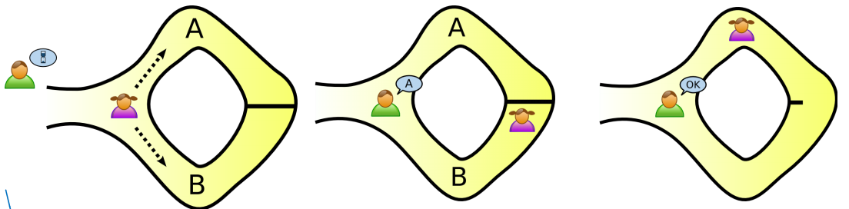
Example: Ali Baba Cave
Alice has the key (magic word) to open the door inside the cave
How can she prove to Bob that she knows the word?

Slide 6
ZK Interactive Proofs Solution
Alice says she has a key to the door in the cave but does not want to show Bob.
Alice proves she has the key by entering the cave, choosing a random direction to go, and waits near the door.
Bob then comes to the cave’s entrance and asks Alice to come out a “random side” of the cave (left/right)
If Alice has the key, then she can always come out the correct side.
If Alice does not have the key, she can only succeed 50% of the time.
The proof: repeat this process many times

Slide 7
This is a zero knowledge proof!
Completeness
After n rounds, prover could only have “fluked” with probability at most 1/2^{n}
Soundness
Verifier instantly knows if prover fails a round
Zero-knowledgeness
Verifier doesn’t learn anything about the key (magic passphrase)

Slide 8
Can we ever prove we know something without revealing the details of the secret?
YES, with Zero Knowledge proofs!
> prove to you that I know the answer to a question without revealing the answer
> In the context of blockchain, allow transactions to be verified without revealing the sender, receiver, or transaction amount

Slide 9
So what are they useful for?
Any system where we require public verification of potentially private information…
...sounds like Blockchain

Slide 10
Brief History of Digital Privacy: CryptoWars (1)
1970s: Cryptography classified as ‘munition’
1980s: Introduction of personal computer meant export controls on encryption protocols
1991: Philip P. Zimmermann open sources PGP
...

Slide 11
Why I Wrote PGP by Philip R. Zimmermann
“Advances in technology will not permit the maintenance of the status quo, as far as privacy is concerned. The status quo is unstable. If we do nothing, new technologies will give the government new automatic surveillance capabilities that Stalin could never have dreamed of. The only way to hold the line on privacy in the information age is strong cryptography.
You don't have to distrust the government to want to use cryptography. Your business can be wiretapped by business rivals, organized crime, or foreign governments. Several foreign governments, for example, admit to using their signals intelligence against companies from other countries to give their own corporations a competitive edge. Ironically, the United States government's restrictions on cryptography in the 1990's have weakened U.S. corporate defenses against foreign intelligence and organized crime.
Throughout the 1990s, I figured that if we want to resist this unsettling trend in the government to outlaw cryptography, one measure we can apply is to use cryptography as much as we can now while it's still legal. When use of strong cryptography becomes popular, it's harder for the government to criminalize it. Therefore, using PGP is good for preserving democracy. If privacy is outlawed, only outlaws will have privacy.”

Slide 12
Brief History of Digital Privacy: CryptoWars (2)
1970s: Cryptography classified as ‘munition’
1980s: Introduction of personal computer meant export controls on encryption protocols
1991: Philip P. Zimmermann open sources PGP
1991-1996: US launches criminal investigation against Zimmermann -- Streisand Effect!
1993: Eric Hughes published A Cypherpunk Manifesto
...

Slide 13
A Cypherpunk Manifesto by Eric Hughes
“Privacy in an open society requires anonymous transaction systems. Until now, cash has been the primary such system. An anonymous transaction system is not a secret transaction system. An anonymous system empowers individuals to reveal their identity when desired and only when desired; this is the essence of privacy.
We must defend our own privacy if we expect to have any. We must come together and create systems which allow anonymous transactions to take place...The technologies of the past did not allow for strong privacy, but electronic technologies do.
We the Cypherpunks are dedicated to building anonymous systems. We are defending our privacy with cryptography, with anonymous mail forwarding systems, with digital signatures, and with electronic money.”

Slide 14
Brief History of Digital Privacy: CryptoWars (3)
1970s: Cryptography classified as ‘munition’
1980s: Introduction of personal computer meant export controls on encryption protocols
1991: Philip P. Zimmermann open sources PGP
1991-1996: US launches criminal investigation against Zimmermann -- Streisand Effect!
1993: Eric Hughes published A Cypherpunk Manifesto
1995-1996: Introduction of SSL and TLS to encrypt communications over the Internet
...

Slide 15
“In the end, I think applying these privacy and anonymity technologies to every blockchain out there is going to be essential because to limit freedom of expression, to limit freedom of association, you don't only have to deal with prior restraint. If you have the freedom to transact with everyone, but all your transactions are visible to everyone, then you can be punished after the fact for transacting with the wrong people, which essentially robs you of your freedom to transact. We have to realise that privacy is a foundational human right and without it, freedom of association, freedom of (political) expression, all go away.”
~ Andreas Antonopolous

Slide 16
Zcash
Building on decades of research, Zcash was developed and launched by top cryptographers from MIT, Technion, John Hopkins, Tel Aviv University, and UC Berkeley. [Zcash](https://z.cash/) is a blockchain that ensures complete confidentiality of transaction data. Zero-knowledge proofs allow transactions to be verified without revealing the sender, receiver or transaction amount.

Slide 17
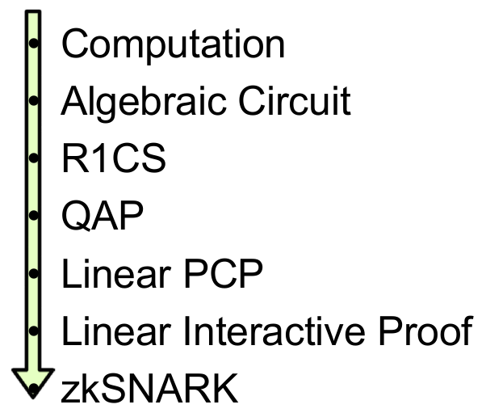
Built on zk-SNARKs
With Zcash, you control what information you share. Shielded addresses and their associated balances are not visible on the blockchain. Payment disclosure and special “viewing keys” can be used to share transaction details with trusted third parties for compliance or audits.

Slide 18
STARK vs SNARK
Main advantage of STARK over SNARK:
NO TRUSTED SETUP (~= TOXIC WASTE)
High-level: (1) Transparency and (2) Scalability
Main advantage of SNARK over STARK:
Shorter proofs (less overhead for storing on blockchain)

Slide 19
Let’s Talk About the Trusted Setup
https://www.wnycstudios.org/story/ceremony

